Slide 1
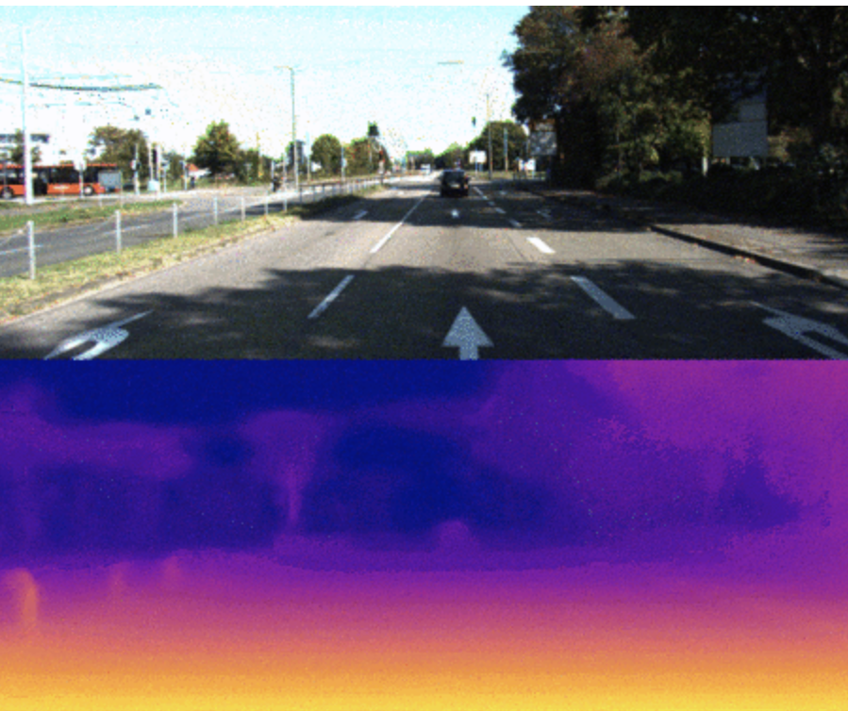
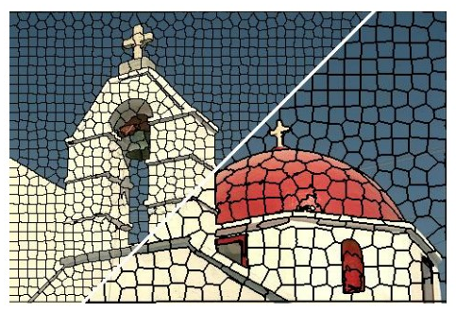
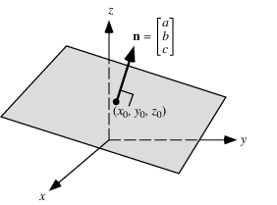
Final Presentation: Piecewise monocular depth estimation by plane fitting
Group 2: Felix Wirth, Korbinian Kunst, Helge Dörsan, Jan Ceccejus
Notes:
benefit of estimating plane coefficients instead of directly estimating depth values is that they can effectively represent depth values of multiple pixels by estimating only 3 coefficients

Slide 2
Agenda
Overview and Goal
Architecture of Baseline NN - Godart et. al 2019
Improvement Approaches
Iteration I: 4 Ch: RGB & SP, Normal2Depth (N2D) Block
Iteration II: 4 Ch + N2D
Iteration III: Superpixel Loss: Binary, Continuous
Iteration IV: Normal in Loss
Final: N2D + Normal Loss & Continuous Superpixel Loss
Results
Further Approaches
Review

Slide 3
Overview incl. Goal
Why is Depth important?
autonomous driving, visual filter
mono: automotive (cost efficient), medical (space restriction), mobile (space restriction)
groundtruth data hard to obtain (lidar is sparse), stereo is rare
History
Eigen [1] 2014 (supervised, introduced autoencoder)
Deep 3D [6], Garg [7], Godard 2017 [8] (unsupervised, Disparity, Left Right Consistency)
Zhou 2017 [3] (Camera Pose Estimation and novel view synthesis)
Godard 2019 - Monodepth 2 [9] (Occlusion sensitive and edge sensitive, our baseline)
improve depth (via surface normal and superpixels)
include normal estimation inside the architecture
show that it is possibility to directly estimate plane coefficients using CNNs
Goal
Notes:
regularization module that can make depth boundaries much sharper

Slide 4
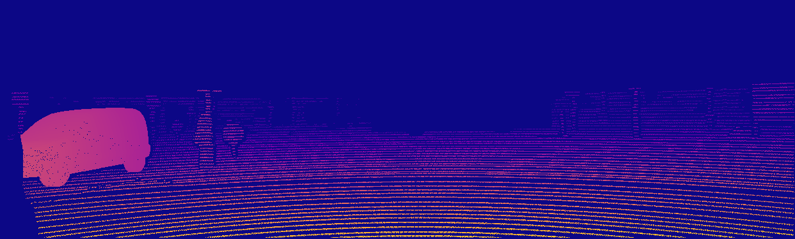
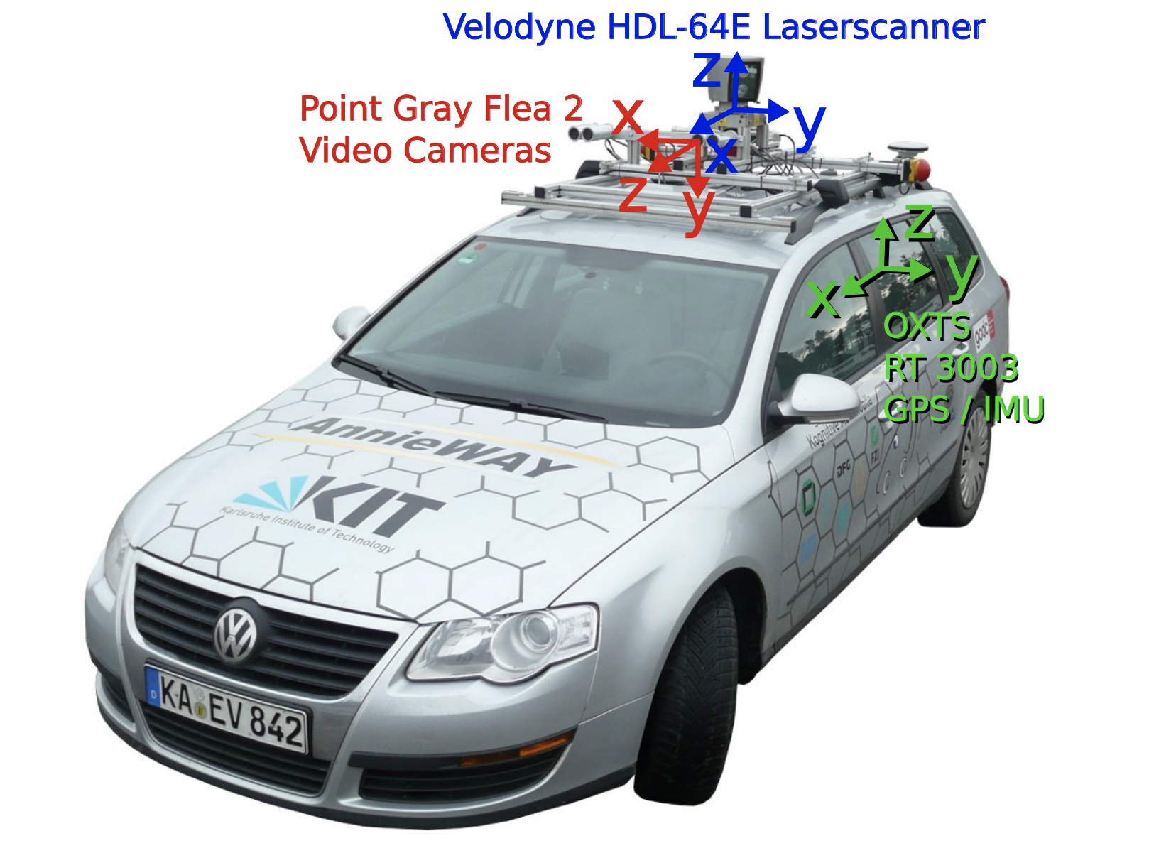
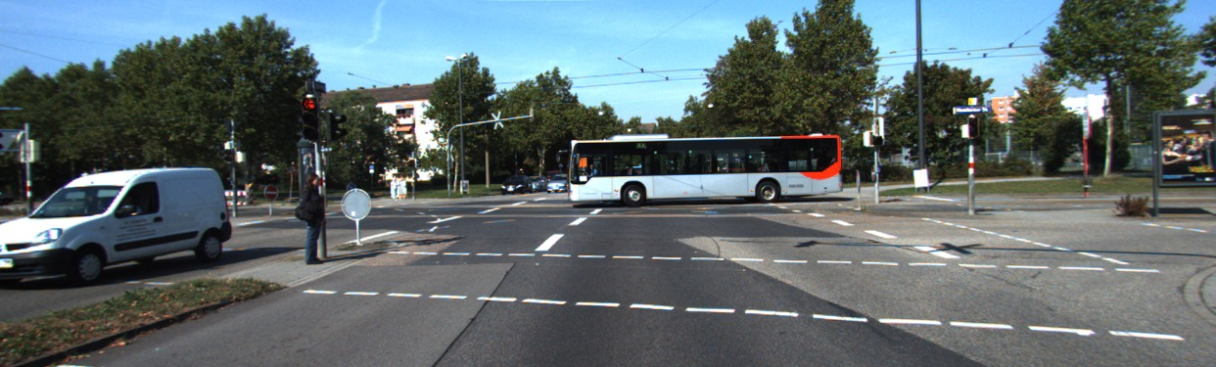
2. Architecture Dataset: KITTI Dataset and Eigensplit
KITTI DATASET [2]
2 high - resolution color and grayscale video cameras
Velodyne laser scanner
EIGEN ZHOU [3]
Subset of KITTI proposed by Eigen in 2014 [1] and modified bei ZHOU in 2017 [3]
uses 39.6K training images, 4424 validation images, and 1000 test images, which are resized to 640 px x 192 px
Notes:
we equipped a standard station wagon with two high-resolution color and grayscale video cameras. Accurate ground truth is provided by a Velodyne laser scanner and a GPS localization system.

Slide 5
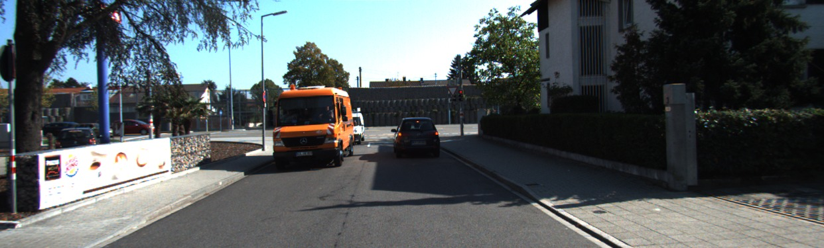
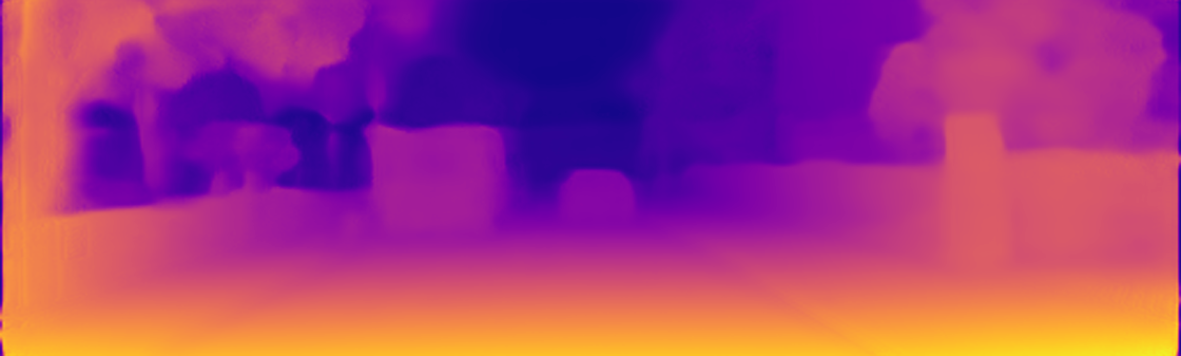
Architecture Overview: Digging Into Self-Supervised Monocular Depth Estimation [1]
Encoder
Depth Decoder
input colors
0
Loss
based on PE
+1
Pose
0
0
DIBR
-1
Output
image
Target
image
augmented images
area of interest

Slide 6

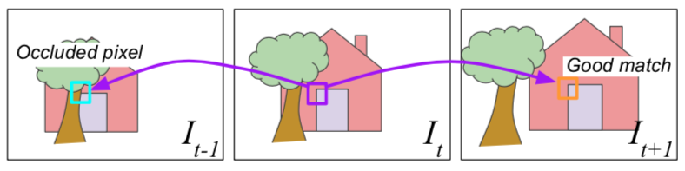
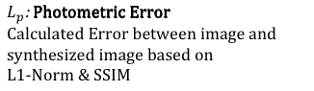
Architecture Loss: Digging Into Self-Supervised Monocular Depth Estimation [1]
Baseline - Loss
$L_{p}$: Photometric Error
Calculated Error between image and synthesized image based on
L1-Norm & SSIM
Minimum Photometric Error
$$L_{p}$$
$L = μ min\left(PE\left(I_{t},I_{t→t^{′ }}\right)\right)+ λ ( \left|{∂_{x}d}_{t}\right|∗e^{\left\{−\left|{∂_{x}I}_{t}\right|\right\}}$ + $\left|{∂_{y} d}_{t}\right|∗e^{\left\{−\left|∂_{y}I_{t}\right|\right\}}$)
$$L_{s}$$
$L_{s}$: Smoothness Error: Ensures smooth gradient expect on edges

Slide 7
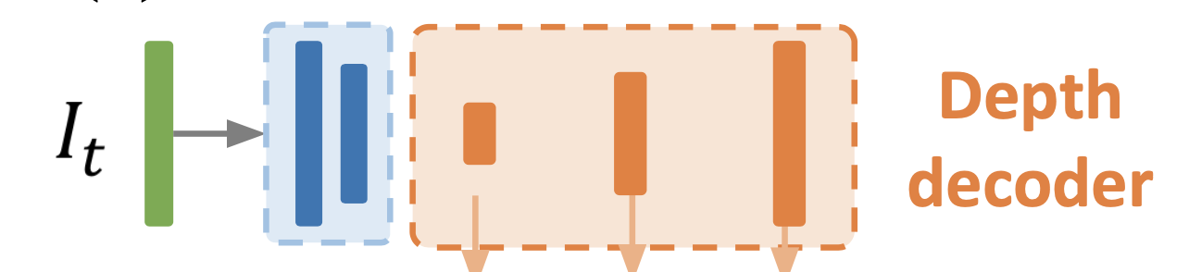
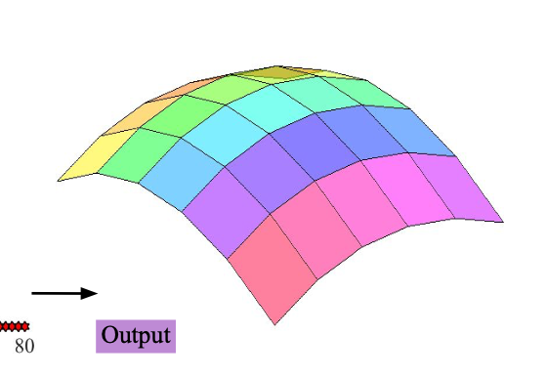
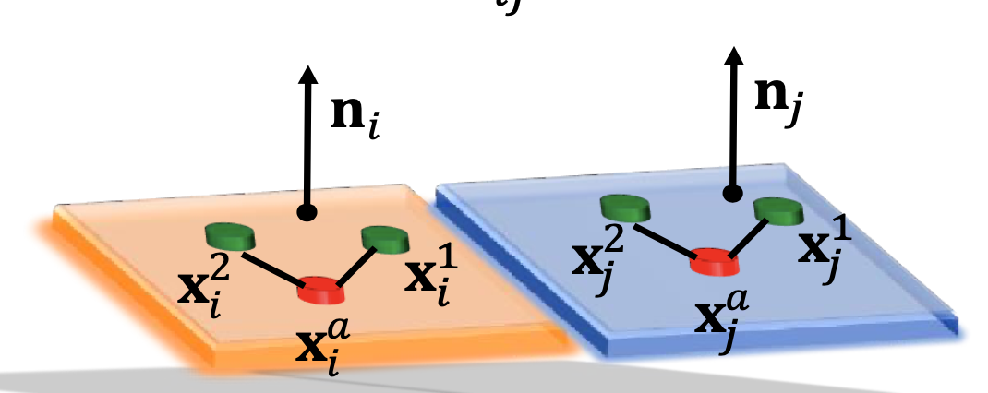
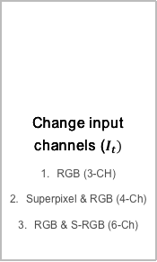
Improvements 3 pillar focus
Input
Architecture
Loss
Change input channels ($I_{t})$
RGB (3-CH)
Superpixel & RGB (4-Ch)
RGB & S-RGB (6-Ch)
normal
Include transformation blocks inside the NN-flow
Normal-to-Depth Block
Averaging Normal based on SP
Let the NN learn with Normal and SP information
improve depth accuracy with superpixel boundary
enforce normal unity constraint on superpixel surface
superpixel

Slide 8
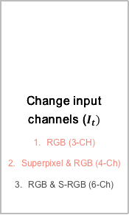
Improvements 3 pillar focus
Input
Architecture
Loss
Change input channels ($I_{t})$
RGB (3-CH)
Superpixel & RGB (4-Ch)
RGB & S-RGB (6-Ch)
normal
Include transformation blocks inside the NN-flow
Normal-to-Depth Block
Averaging Normal based on SP
Let the NN learn with Normal and SP information
improve depth accuracy with superpixel boundary
enforce normal unity constraint on superpixel surface
superpixel

Slide 9
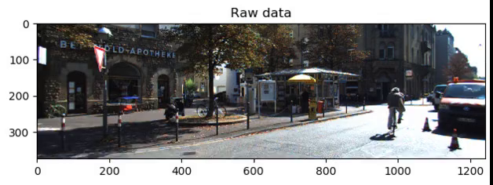
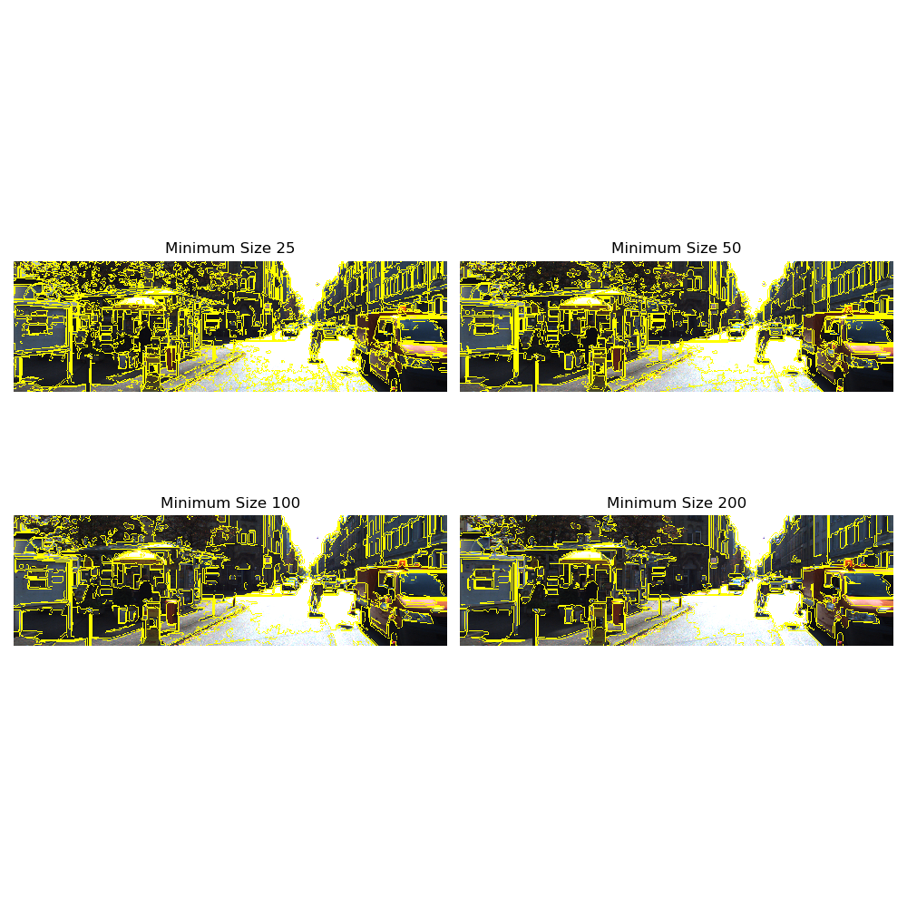
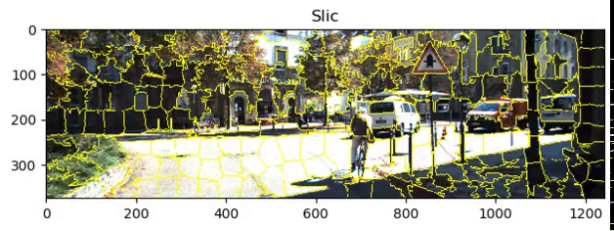
Improvements Iteration I: Basic I - Superpixel
Def: superpixel can be defined as a group of pixels that share common characteristics (e.g. pixel intensity)
current favorite: SLIC
Conclusion
superpixel can be usefull additional information for the net to approximate depth since they model surfaces and reduce image complexity into a composition of multiple planes

Slide 10
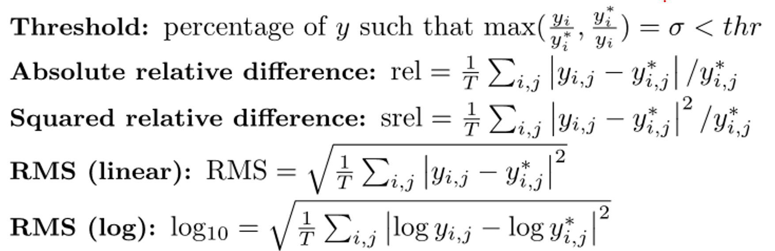
Improvements Iteration I: 4 Channel Input (Superpixel & RGB)
Testing: Abs. rel. Error
Baseline: 0.115
Current: 0.141
+ 22%

Slide 11
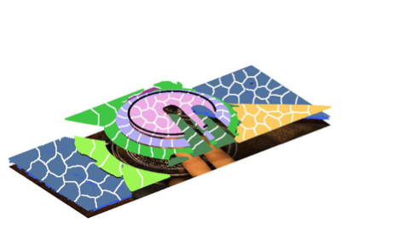
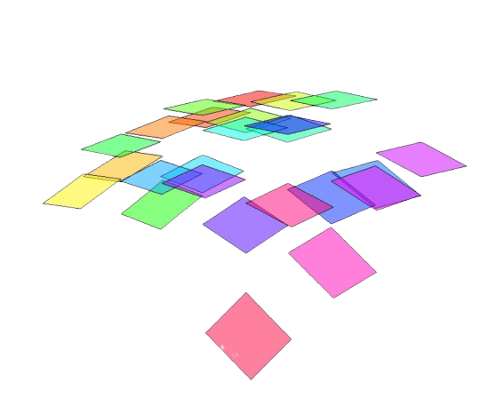
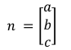
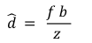
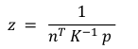
3. Improvements Iteration I: Basic II - Normal Computation
$$n =\left[\begin{matrix}a \\ b \\ c\end{matrix}\right]$$
s
$$z$$
1
$$p = K P$$
$$P = K^{−1} p$$
P (X,Y,Z)
2
$$n^{T} P = 1$$
Depth Estimation
3
$$P = {{(K}^{−1} p)}_{homo} z$$
$$z = \frac{1}{n^{T} K^{−1} p }$$
p (x,y)
normal to disparity
Disparity
4
$$\hat{d} = \frac{f b }{z }$$
$$(0, 0, 0)$$

Slide 12
3. Improvements Iteration II: Introducing N2D Block
Encoder
Normal Decoder
Depth Decoder
input colors
0
Loss
normal to disparity
+1
Pose
0
0
DIBR
-1
Output
colors
Target
colors
augmented images

Slide 13
Improvements Iteration I: Normal 2 Depth Block
Testing: Abs. rel. Error
Baseline: 0.115
Current: 0.123
+6.9%

Slide 14
Improvements Iteration II: 4 Ch + N2D Block
Testing: Abs. rel. Error
Baseline: 0.115
Current 0.142
+23%

Slide 15
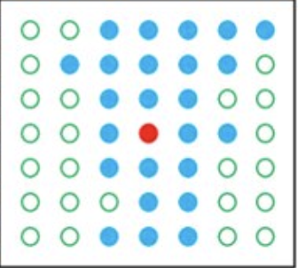
3 . Improvements Iteration III: Superpixel in Loss Function
Encoder
Superpixel
Depth Decoder
input RGB
Loss
Pose
0
0
+1
DIBR
Output
image
Target
image
-1
augmented images

Slide 16
3 . Improvements Iteration III: Superpixel in Loss Function
Concept Idea
use Superpixel information in implementing loss function
Problem: Oversegmentation:
- one plane is represented multiple superpixel segements
1
2
1
 |  | 1 | 1 | 2
 | 1 | 1 | 1 | 2 | 2
 | 1 | 1 | 2 | 2 | 2
 | 3 | 3 | 3 | 2 | 2
 |  | 3 | 3 | 3
 |  | 1 | 1 | 1
 | 1 | 1 | 1 | 1 | 1
 | 1 | 1 | 1 | 1 | 1
 | 1 | 1 | 1 | 1 | 1
 |  | 1 | 1 | 1
3
1
Join Superpixels on same surface
Minimize the disparity gradient in y and x direction in one plane
→ Let edges be rough

Slide 17
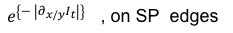
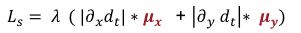
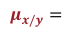
3 . Improvements Iteration III: Binary & Continuous Superpixel Loss
Mathematical Implementation
Superpixel - Loss
Goal – Create Superpixel mask
$L_{s}= λ ( \left|{∂_{x}d}_{t}\right|∗μ_{x}$ + $\left|{∂_{y} d}_{t}\right|{∗ μ}_{y})$
SP-Loss binary
SP-Loss continuous
0 , on edges
$e^{\left\{−\left|{∂_{x/y}I}_{t}\right|\right\}}$ , on SP edges
$$μ_{x/y}=$$
$$μ_{x/y}=$$
1 , inside plane
1 , inside SP

Slide 18
Improvements Iteration III: Binary Superpixel Loss
Testing: Abs. rel. Error
Baseline: 0.115
Current: 0.443
+398%

Slide 19
Improvements Iteration III: Continuous Superpixel Loss
Testing: Abs. rel. Error
Baseline: 0.115
Current: 0.138
+20%

Slide 20
3. Improvements Iteration IV: Normals in Loss Function
Encoder
Normal Decoder
Depth Decoder
input colors
0
normal to disparity
+1
Loss
Pose
DIBR
0
0
-1
Output
colors
Target
colors
augmented images

Slide 21
Loss Function Normals in Loss Function
Concept Idea
Implementation
Force normals to be equal inside SPs
Treat superpixels as planes represented by one normal vector

Slide 22
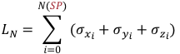
Loss Function Normals in Loss Function
Concept Idea
Implementation
$$L_{N}=\sum_{i=0}^{N(SP)}{(σ_{x_{i}}+σ_{y_{i}}+σ_{z_{i}})}$$
$$L=μL_{p}+λL_{s}+αL_{N}$$
Force normals to be equal inside SPs
$L_{p}$: Photometric Loss
Treat superpixels as planes represented by one normal vector
$L_{s}$: Smoothness Loss
$L_{N}$: Normal Loss

Slide 23

Improvements Iteration IV: Normals in Loss Function
Testing: Abs. rel. Error
Baseline: 0.115
Current: still running

Slide 24
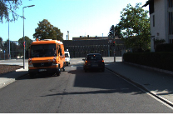
Improvements Iteration V: Normal Loss & Continuous Superpixel Loss
Superpixel
input RGB
normal to disparity
+1
Pose
Output colors
Target colors
DIBR
0
0
-1
Loss
$$L = μ L_{p} + λ L_{s} + αL_{N}$$
augmented images

Slide 25
Improvements Iteration V: Normal Loss & Continuous Superpixel Loss
Testing: Abs. rel. Error
Baseline: 0.115
Current: still running

Slide 26
4. Results All Approaches
Run | Input | Architecture | Loss Function | Run-Time | absolute relative error*
0 | RGB | Baseline | Baseline | 12 h | 0,115
1 | RGB+Superpixel | Baseline | Baseline | 22 h | 0,141
2 | RGB | Normal-to-Depth Block | Baseline | 14 h | 0,123
3 | RGB+Superpixel | Normal-to-Depth Block | Baseline | 24 h | 0,142
4 | RGB+Superpixel | Normal-to-Depth Block | Binary | 15 h | 0,443
5 | RGB | Normal-to-Depth Block | Binary | 17 h | 0,443
6 | RGB+Superpixel | Normal-to-Depth Block | Continous | 14 h | 0,138
7 | RGB | Normal-to-Depth Block | Continous | 15 h | 0,443
8 | RGB+Superpixel | Normal-to-Depth Block | Normal loss | 55 h | 0,139
9 | RGB+Superpixel | Normal-to-Depth Block | Cont + normal | 50 h | 0,141
10 | RGB+Superpixel | Normal-to-Depth Block | Binary + normal | Still running
11 | RGB+Superpixel | Averaging Normal based on SP | baseline | Still running
12 | RGB+Superpixel | Normal-to-Depth Block + Averaging Normal based on SP | baseline | Still running

Slide 27
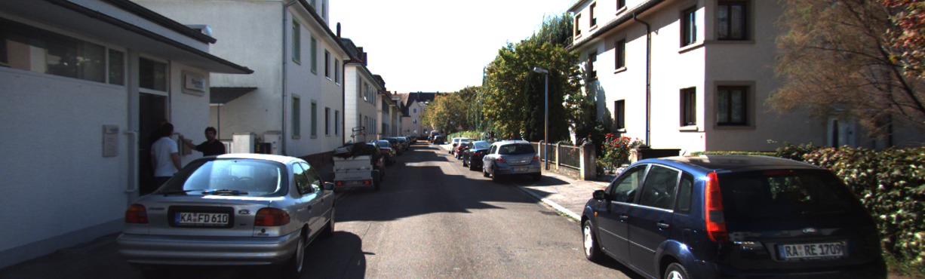
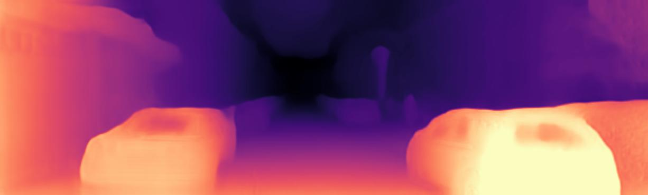
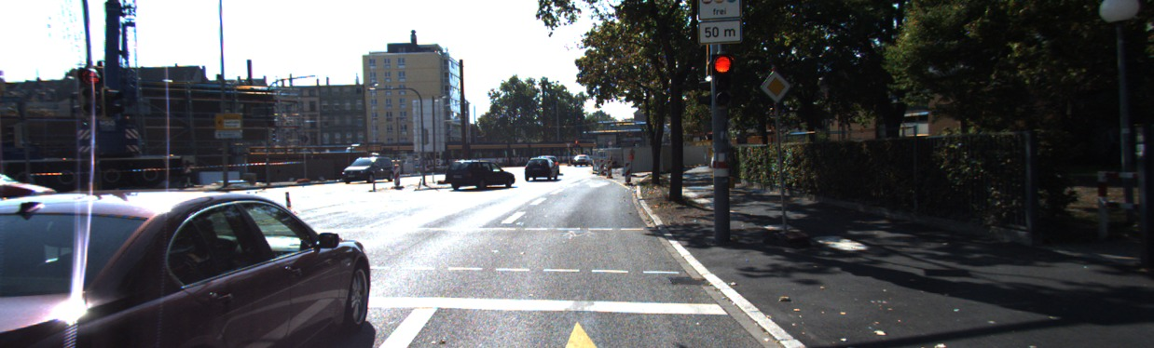
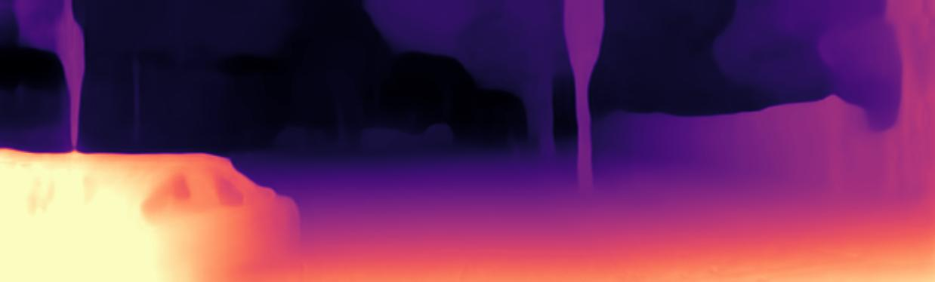
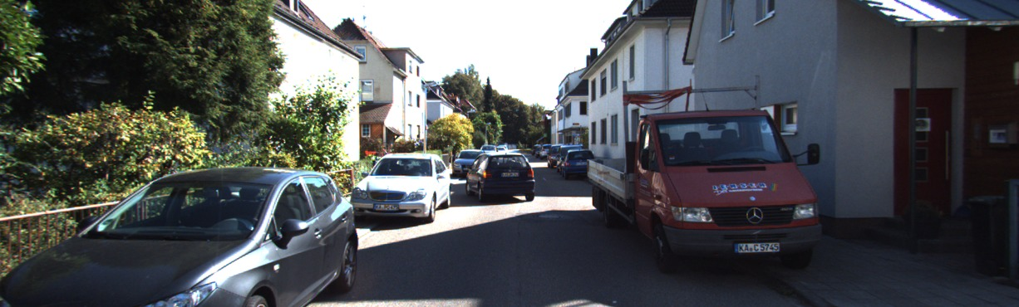
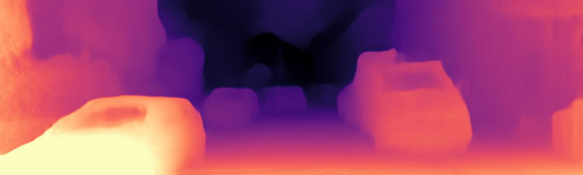
4. Results Demo: Compare Results
Evaluation of our result based on three test images
chosen on criteria: close objetcs, open streets, buildings, street shields
Baseline

Slide 28
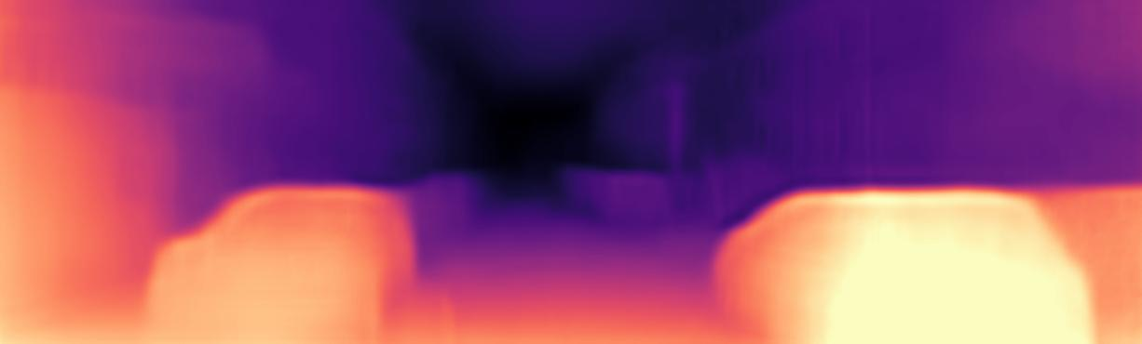
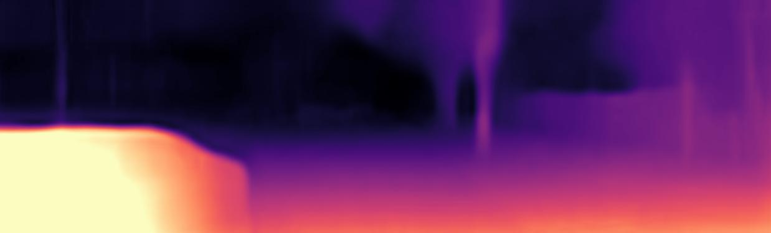
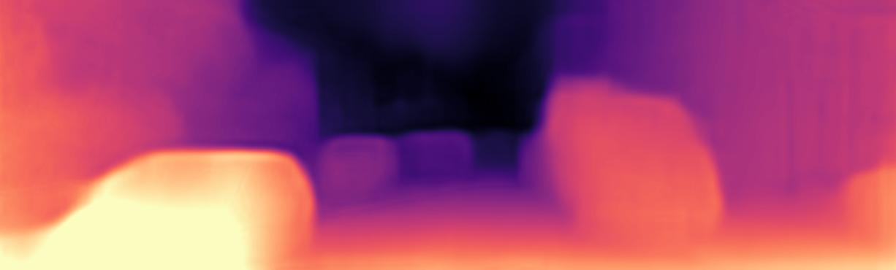
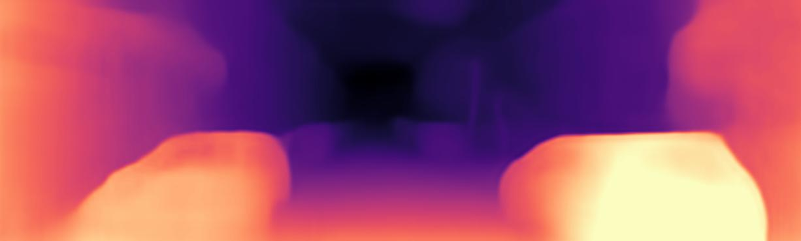
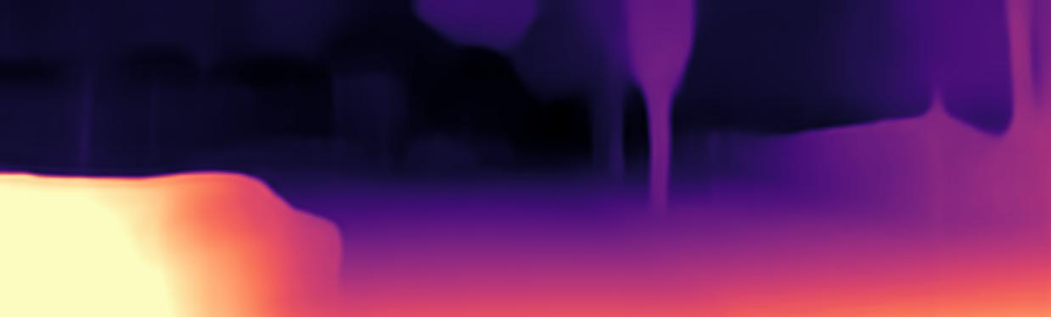
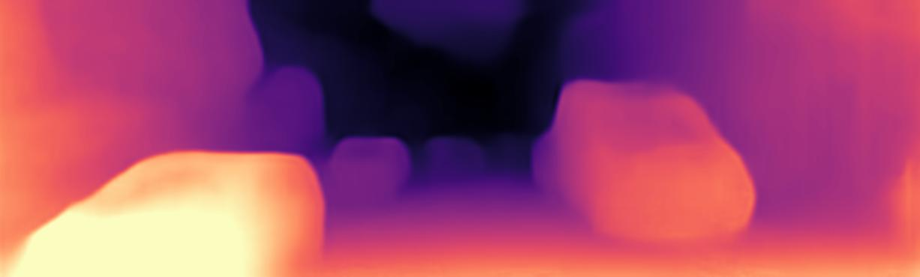
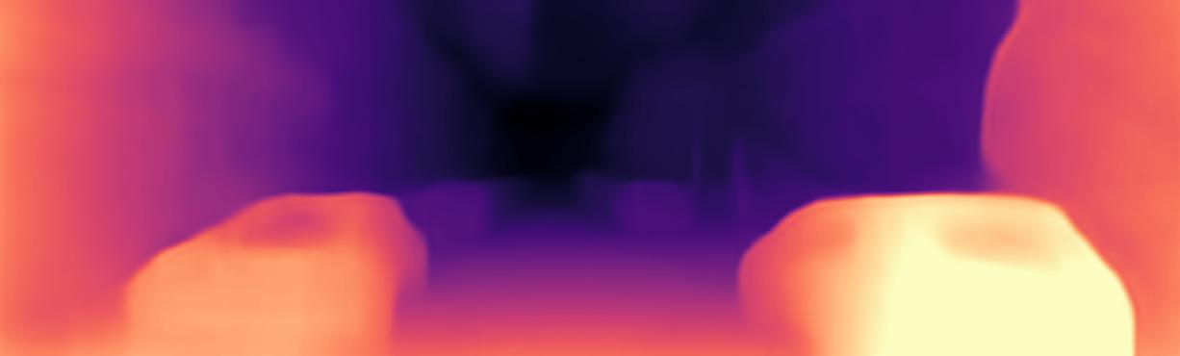
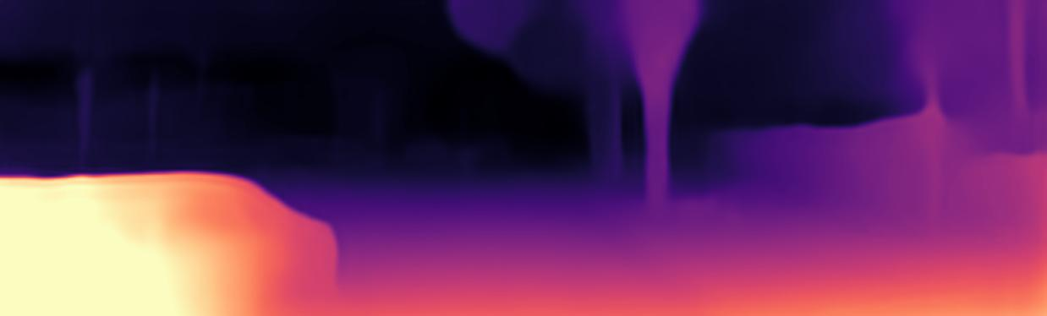
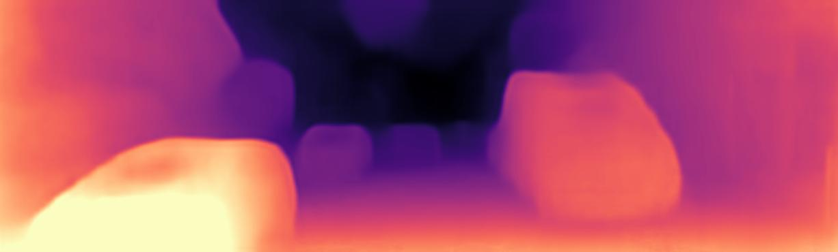
4. Results Demo II
Baseline
3 Ch + Normal 2 Depth Block
4 Ch (RGB+SP) + Normal 2 Depth Block + Superpixel Cotinuous Loss
4 Ch (RGB + SP) + Normal 2 Depth Block + Superpixel Cotinuous Loss + Normal Loss

Slide 29
4. Results Demo II
3 Ch + Normal 2 Depth Block
3 Ch + Normal 2 Depth Block
4 Ch + Normal 2 Depth Bloc + Superpixel Cotinuous Loss
4 Ch (RGB + SP) + Normal 2 Depth Block + Superpixel Cotinuous Loss + Normal Loss

Slide 30
4. Results Demo II
Baseline
4 Ch + Normal 2 Depth Block + Superpixel Cotinuous Loss
3 Ch + Normal 2 Depth Block
4 Ch + Normal2Depth Block + SP Cotinuous Loss + Normal Loss

Slide 31
4. Results Demo II
3 Ch + Normal 2 Depth Block
4 Ch + Normal 2 Depth Block + Superpixel Cotinuous Loss
4 Ch (RGB + SP) + Normal 2 Depth Block + Superpixel Cotinuous Loss + Normal Loss

Slide 32
4. Results Demo II
3 Ch + Normal 2 Depth Block
4 Ch + Normal 2 Depth Block + Superpixel Cotinuous Loss
4 Ch (RGB + SP) + Normal 2 Depth Block + Superpixel Cotinuous Loss + Normal Loss

Slide 33
4. Results Demo II
Baseline
4 Ch + Normal 2 Depth Block + Superpixel Cotinuous Loss
3 Ch + Normal 2 Depth Block
4 Ch (RGB + SP) + Normal 2 Depth Block

Slide 34
4. Results Demo II
3 Ch + Normal 2 Depth Block
4 Ch + Normal 2 Depth Bloc + Superpixel Cotinuous Loss
4 Ch (RGB + SP) + Normal 2 Depth Block + Superpixel Cotinuous Loss + Normal Loss

Slide 35
4. Results Demo II
Baseline
4 Ch + Normal 2 Depth Block
3 Ch + Normal 2 Depth Block
4 Ch + Normal 2 Depth Block + Superpixel Cotinuous Loss
4 Ch + Normal 2 Depth Block + Superpixel Cotinuous Loss
4 Ch (RGB + SP) + Normal 2 Depth Block

Slide 36
4. Results Demo II
Baseline
4 Ch + Normal 2 Depth Block
3 Ch + Normal 2 Depth Block
4 Ch + Normal 2 Depth Block + Superpixel Cotinuous Loss
4 Ch + Normal 2 Depth Block + Superpixel Cotinuous Loss
4 Ch (RGB + SP) + Normal 2 Depth Block

Slide 37
4. Results Demo II
Baseline
4 Ch + Normal 2 Depth Block + Superpixel Cotinuous Loss
3 Ch + Normal 2 Depth Block
4 Ch + Normal 2 Depth Block + Superpixel Cotinuous Loss
4 Ch (RGB + SP) + Normal 2 Depth Block + Superpixel Cotinuous Loss + Normal Loss
4 Ch (RGB + SP) + Normal 2 Depth Block + Superpixel Cotinuous Loss + Normal Loss

Slide 38
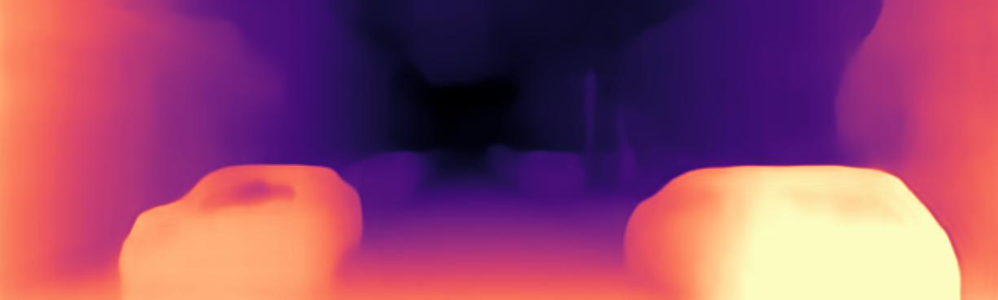
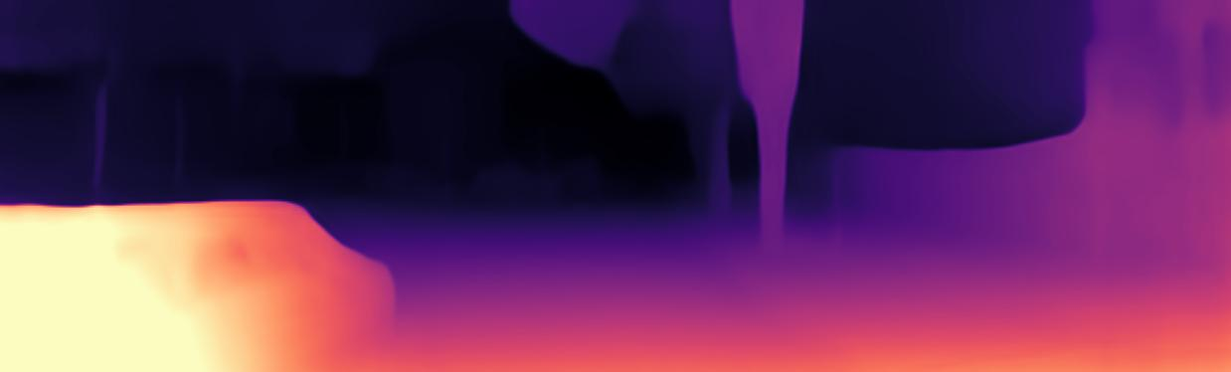
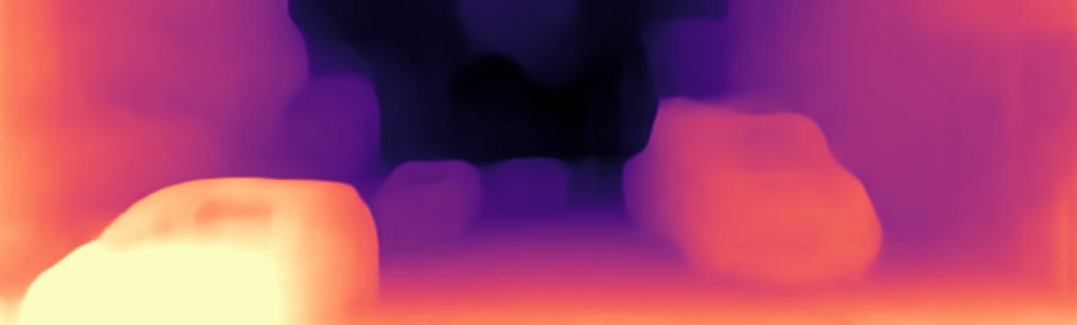
4. Results Demo II
3 ch + Normal Decoder
Depth Maps are far from perfect in general (e.g. missing shields)
Normal Approach shows windows as one plane
Building border tend to be sharper, Trees are recognized
Superpixel and Continuous Loss show most promising loss results - final depth maps are still pending unfortunately
Conclusion
4 ch + Depth Decoder
4 ch + Normal Decoder

Slide 39

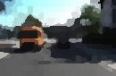
5. Further approaches Improvement of Loss
Use centroid information for superface surface modifikation
Centroid Normal
Averaging
input RGB
improved Depth
SP-Pooling Layer
Superpixel
Learn Superpixel with hyperparameter an learning part itself
Superpixel Sampling Network (SSN)
Deep Network
differentiable SLIC
input RGB
improved superpixel

Slide 40
6. Review
Understanding the literature and getting acquainted with a deep learning library (PyTorch)
Prepare the dataset and run baseline
Choose perfered superpixel generation algorithm and generate new dataset
create new loss functions
train the network to estimate the normal coefficients
Evaluate the result on public benchmark datasets
beat current network error score
Writing of a report
√
√
√
√
√
√
×
×

Slide 41
Literature
[1] D Eigen, C Puhrsch, and R Fergus. Depth map prediction from a single image using a multi-scale deep network.In Advances in Neural Information Processing Systems, 2014.
[2] A. Geiger, P. Lenz and R. Urtasun, "Are we ready for autonomous driving? The KITTI vision benchmark suite," 2012 IEEE Conference on Computer Vision and Pattern Recognition, Providence, RI, 2012, pp. 3354-3361.
[3] Tinghui Zhou, Matthew Brown, Noah Snavely, David Lowe, “Unsupervised Learning of Depth and Ego-Motion” from Video in CVPR 2017
[4] D. Stutz, A. Hermans, B.Leibe, Superpixels: An Evaluation of the State-of-the-Art
[5] Murong Wang, Xiabi Liu, Yixuan Gao, Xiao Ma, Nouman Q. Soomro, Superpixel segmentation: A benchmark, Signal Processing: Image Communication, Volume 56, 2017, Pages 28-39,
[6] Junyuan Xie and Ross Girshick and Ali Farhadi, Deep3D: Fully Automatic 2D-to-3D Video Conversion with Deep Convolutional Neural Networks, 2016
[7] Ravi Garg and Vijay Kumar BG and Gustavo Carneiro and Ian Reid, Unsupervised CNN for Single View Depth Estimation: Geometry to the Rescue, 2016
[8] Clément Godard and Oisin Mac Aodha and Gabriel J. Brostow, Unsupervised Monocular Depth Estimation with Left-Right Consistency, 2016
[9] Clement Godard and Oisin Mac Aodha and Michael Firman and Gabriel J. Brostow, Digging into Self-Supervised Monocular Depth Prediction, 2019

Slide 42
7. Backup Slides
Net Detail View
Superpixel Benchmark Paramter
Error Metrics

Slide 43
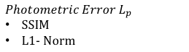


Architecture LOSS: Digging Into Self-Supervised Monocular Depth Estimation [1]
$$Photometric Error L_{p}$$
SSIM
L1- Norm
Depth
Pose
$I_{t→t^{′ }}$= $I_t<proj(D_{t},T_{t→t^{′} },K)>$
$$L= μ∗min\left( \frac{α}{2} \left(1 −SSIM\left(I_{t},I_{t→t^{′ }}\right)\right)+\left(1−α\right) \left\|I_{t}−I_{t→t^{′ }}\right\|\right)$$
$+ λ ( \left|{∂_{x}d}_{t}\right|∗e^{\left\{−\left|{∂_{x}I}_{t}\right|\right\}}$ + $\left|{∂_{y} d}_{t}\right|∗e^{\left\{−\left|∂_{y}I_{t}\right|\right\}}$)
$$Smoothness Loss{ L}_{s}$$
${∂_{i}d}_{t}:Gradient smoothness$
$e^{\left\{∂_{x}\left|I_{t}\right|\right\}}:Edge aware smoothness$
Disparity

Slide 44



Loss Function Superpixel Binary Loss Function
Mathematical Implementation
Binary SP-Loss
as part of the smoothness loss
$λ ( \left|{∂_{x}d}_{t}\right|∗e^{\left\{−\left|{∂_{x}I}_{t}\right|\right\}}$ + $\left|{∂_{y} d}_{t}\right|∗e^{\left\{−\left|∂_{y}I_{t}\right|\right\}}$
Goal
Calculate gradient of SP-labels
$\left|∂_{x} SP\right|$ & $\left|∂_{y }SP\right|$
$L_{s}= λ ( \left|{∂_{x}d}_{t}\right|∗μ_{x}$ + $\left|{∂_{y} d}_{t}\right|{∗ μ}_{y})$
If $\left|∂_{x/y} SP\right|$ ~= 0 & $\left|{∂_{x/y} I}_{t}\right|<threshold:$
$\left|∂_{x/y} SP\right|$ = 0
else:
$\left|∂_{x/y} SP\right|$ = 1
0 , on edges
$$μ_{x/y}=$$
1 , inside plane

Slide 45



Loss Function Superpixel Continuous Loss Function
Mathematical Implementation
Continuous SP-Loss
as part of the smoothness loss
$λ ( \left|{∂_{x}d}_{t}\right|∗e^{\left\{−\left|{∂_{x}I}_{t}\right|\right\}}$ + $\left|{∂_{y} d}_{t}\right|∗e^{\left\{−\left|∂_{y}I_{t}\right|\right\}}$
Goal
Calculate gradient of SP-labels
$\left|∂_{x} SP\right|$ & $\left|∂_{y }SP\right|$
$L_{s}= λ ( \left|{∂_{x}d}_{t}\right|∗μ_{x}$ + $\left|{∂_{y} d}_{t}\right|{∗ μ}_{y})$
If $\left|∂_{x/y} SP\right|$ ~= 0 :
$\left|∂_{x/y} SP\right|$ = $e^{\left\{−\left|{∂_{x/y}I}_{t}\right|\right\}}$
else:
$\left|∂_{x/y} SP\right|$ = 1
$e^{\left\{−\left|{∂_{x/y}I}_{t}\right|\right\}}$ , on SP-edges
$$μ_{x/y}=$$
1 , inside SP

Slide 46
Architecture Detail View: Digging deeper into Monocular View [1]

Slide 47


Improvements Basic I: Superpixel - Demo on KITTI
Conclusion
superpixel can be usefull additional information for the net to approximate depth since they model surfaces and reduce image complexity into a composition of multiple planes

Slide 48

Superpixel Benchmark Parameters
Boundary Recall (Rec)
is the most commonly used metric to asses boundary adherence given ground truth
FN(G; S) be the number of false negative boundary pixels
TP(G; S) be the number of true positive boundary pixels

Slide 49



Superpixel Benchmark Parameters
Undersegmentation Error (UE)
Measures the “leakage" of superpixels with respect to G
Different approaches
Original (Levinshtein et al.)
Thresholded leakage (van den Bergh et al. and Neubert and Protzel)

Slide 50

Superpixel Benchmark Parameters
Explained Variation (EV)
quanties the quality of a superpixel segmentation without relying on ground truth
µ (Sj) and µ(I) are the mean color of superpixel Sj and the image I

Slide 51

Superpixel Benchmark Parameters
Compactness (CO)
compares the area A(Sj) of each superpixel Sj with the area of a circle (the most compact 2-dimensional shape) with same perimeter P(Sj ), i.e. higher is better.

Slide 52
Benchmark of depth estimation Algorithm some commonly used error metrics:
Error Metrics
With Y = predicted depth map, Y* = ground truth depth image and T = pixel depth
Groundtruh
For example outdoor datasets (Hight depth range / less depth resolution)
KITTI – Depth by LIDAR
Make3D – Depth by LIDAR

Slide 53
Improvements Iteration I: Normal 2 Depth Block
4 CH Input
superpixel can be usefull additional information for the net to approximate depth since they model surfaces and reduce image complexity into a composition of multiple planes

Slide 54
Architecture New Input: RGB
Encoder
Depth Decoder
0
input RGB
input Superpixel
Loss
Pose
0
0
+1
DIBR
-1
Output
image
Output
image
augmented images

Slide 55
4. Results Focus on three significant approaches
30%
30%
12%
Data title here
A peep at some distant orb has power to raise and purify our thoughts like a strain of sacred music
Data title here
A peep at some distant orb has power to raise and purify our thoughts like a strain of sacred music
Data title here
A peep at some distant orb has power to raise and purify our thoughts like a strain of sacred music

Slide 56
3. Improvements Iteration I: Basic II - Normal Computation
$$n =\left[\begin{matrix}a \\ b \\ c\end{matrix}\right]$$
s
$$z$$
1
$$p = K P$$
P (X,Y,Z)
$$P = K^{−1} p$$
2
$$n^{T} P = 1$$
Depth Estimation
p (x,y)
$$P = {{(K}^{−1} p)}_{homo} z$$
3
$$z = \frac{1}{n^{T} K^{−1} p }$$
normal to disparity
Disparity
4
$$\hat{d} = \frac{f b }{z }$$
$$(0, 0, 0)$$

Slide 57

3. Improvements Improvement normals with Superpixel
use Superpixel information for uniforming normals
Goal: ensure sharp edges of surface in depth map
in architecture
in loss
Timeline Title
A peep at some distant orb has power to raise and purify our thoughts like a strain.
Timeline Title
A peep at some distant orb has power to raise and purify our thoughts like a strain.
SP-Pooling Layer

